Slide 1
SMARTPHONE SPECIFICATION TREND ANALYSIS USING PYTHON
SUBMITTER BY :- SEJAL

Slide 2
CONTENTS
Company Profile
Drawback
Introduction
Objective
Module
Advantage
Tool & Technologies
Flowchart
Dataset Overview
DFD
Data Cleaning
Visualization
Future & Scope
Conclusion

Slide 3

Certification: ISO 9001:2015 Certified Specializations: - Web Development - Mobile Application Development - Custom Software Development - UI/UX Design - Hosting Services - Digital Marketing Services: - Advanced IT solutions supporting the entire business - Consulting to system development Headquarters: Jalandhar Branch Office: Hoshiarpur
COMPANY PROFILE

Slide 4
Company Name: O7 Solutions IT Company Founded: 2017 Certification: ISO 9001:2015 Certified Specializations: - Mobile Development - Web Development - Software Development - Digital Marketing - IT Integration Experience: Over 7 years
COMPANY PROFILE

Slide 5
Drawbacks of Existing System
No Visual Insight :- No clear comparison Between brand and features.
Manual & Time-Consuming:- Difficult to find Best value Phone without Analysis.
Unstructured Data :- Hard to understand without cleaning.
No clear Price Analysis:- Smartphone price could not be compared by features or brands.

Slide 6
INTRODUCTION
Analyzes how smartphone features affect pricing
Key attributes: RAM, Storage, Battery, Camera, Display
Used Python libraries: Pandas, NumPy, Matplotlib
Helps consumers and businesses understand price-driving factors
Identifies trends and correlations in pricing
Helps consumers choose better-value smartphones

Slide 7
Objective / Solution
Analyze smartphone data using Python and data science libraries.
Identify which features (RAM, Camera, Battery, etc.) impact price.
Visualize relationships between specs and pricing using charts.
Compare pricing trends across different mobile brands.

Slide 8
MODULE
Data Collection :- Gather smartphone specs and pricing data from reliable sources (e.g., Kaggle).
Data Preprocessing :- Clean, format, and structure the raw data for analysis.
Exploratory Data Analysis (EDA) :- Use graphs to find trends (e.g., Price vs. RAM, Storage, Brand).
Visualization :- Create charts and plots using Python libraries (Matplotlib, Seaborn).
Result Interpretation :- Analyze findings to understand what features impact price the most.
Conclusion & Insights Help users and businesses make informed decisions based on results.

Slide 9
Advantages of Project
Price Comparison Made Easy :- Users can compare prices across brands and specifications quickly.
Informed Buying Decisions :- Consumers choose the best smartphone based on RAM, storage, battery, etc.
Market Trend Analysis :- Identifies trends by brand, features, or region.
Fast Insights Through Graphs :- Visuals make understanding complex data quick and simple.
Learning Outcome for Analysts :- Gain hands-on experience with Python, Pandas, Matplotlib, and real-world datasets.

Slide 10
Tools & Technologies
Layer | Technology | Purpose
Data Analysis | Python | Core language for analysis, scripting, and automation
Libraries | Pandas | Data manipulation, filtering, cleaning
 | NumPy | Numerical operations, array handling
 | Matplotlib | Visualization using bar, line, scatter plots
 | Seaborn | Advanced statistical graphs and plots
Environment | Jupyter Notebook | Interactive coding and analysis
Dataset Source | Kaggle | Public dataset for mobile specs and prices

Slide 11
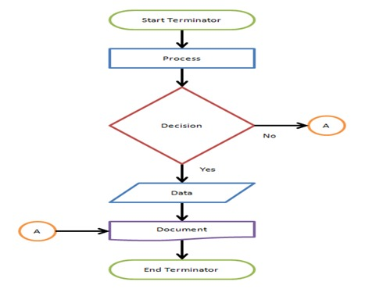
FLOWCHART
A flowchart is a picture of boxes that indicates the process flow sequentially.
It is a pictorial way of representing steps that are preferred by most beginner-level programmers to understand algorithms of computer science

Slide 12
Dataset Overview
Source of Dataset
Platform :- Kaggle
Dataset Name :- Mobile Phones Specifications and Prices
Covers
Global smartphone specifications
Launch prices across countries
Technical hardware details
Key features like camera, display, battery, storage
Purpose of Dataset
Price comparison & market trend analysis
Data analysis and machine learning use

Slide 13
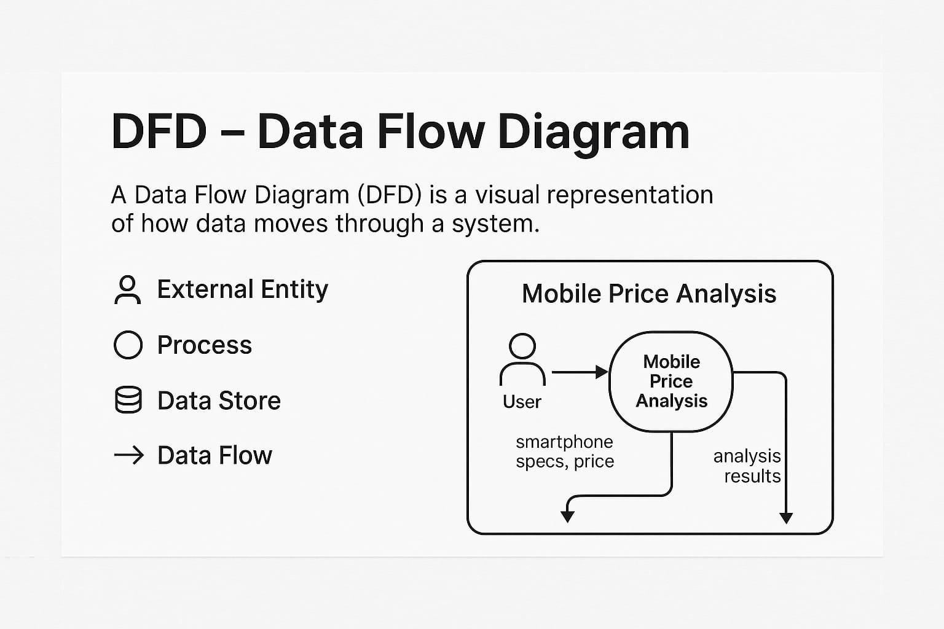
Data Flow Diagram (DFD)
Here is the meaning of each DFD (Data Flow Diagram) symbol explained In points:
External Entity – Outside user or system (e.g., User giving input)
Process – Action performed by the system (e.g., Mobile Price Analysis)
Data Store – Saves data like databases (e.g., Smartphone Specs)
Data Flow – Shows how data moves between parts (e.g., User Process)

Slide 14
DATA CLEANING
Handled Null Values: Missing values were filled using mean/median or removed if not useful.
Data Type Conversion: Converted string-based numbers (e.g., "6GB") into proper numeric types.
Removed Duplicates: Deleted duplicate rows to avoid repetition in analysis.
Reindexing & Renaming: Reindexed rows and renamed columns for better readability.

Slide 15
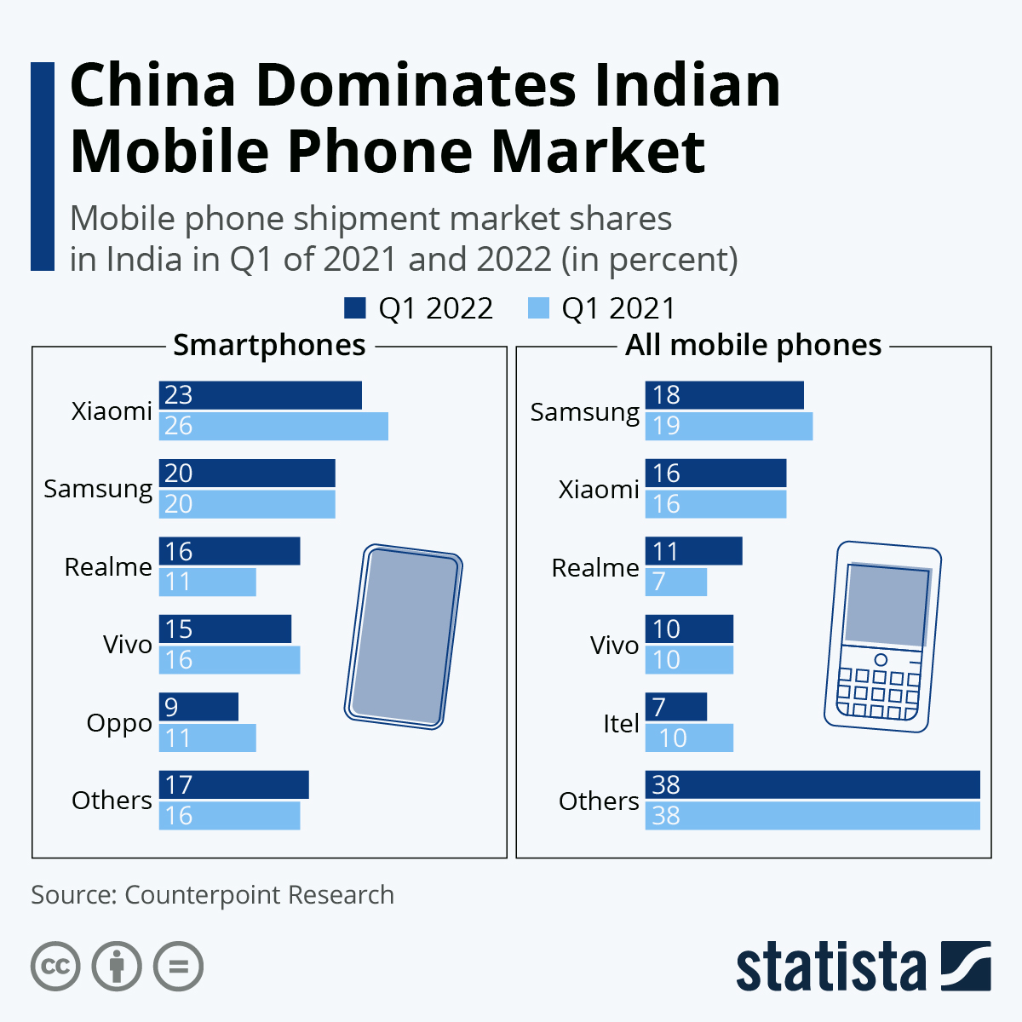
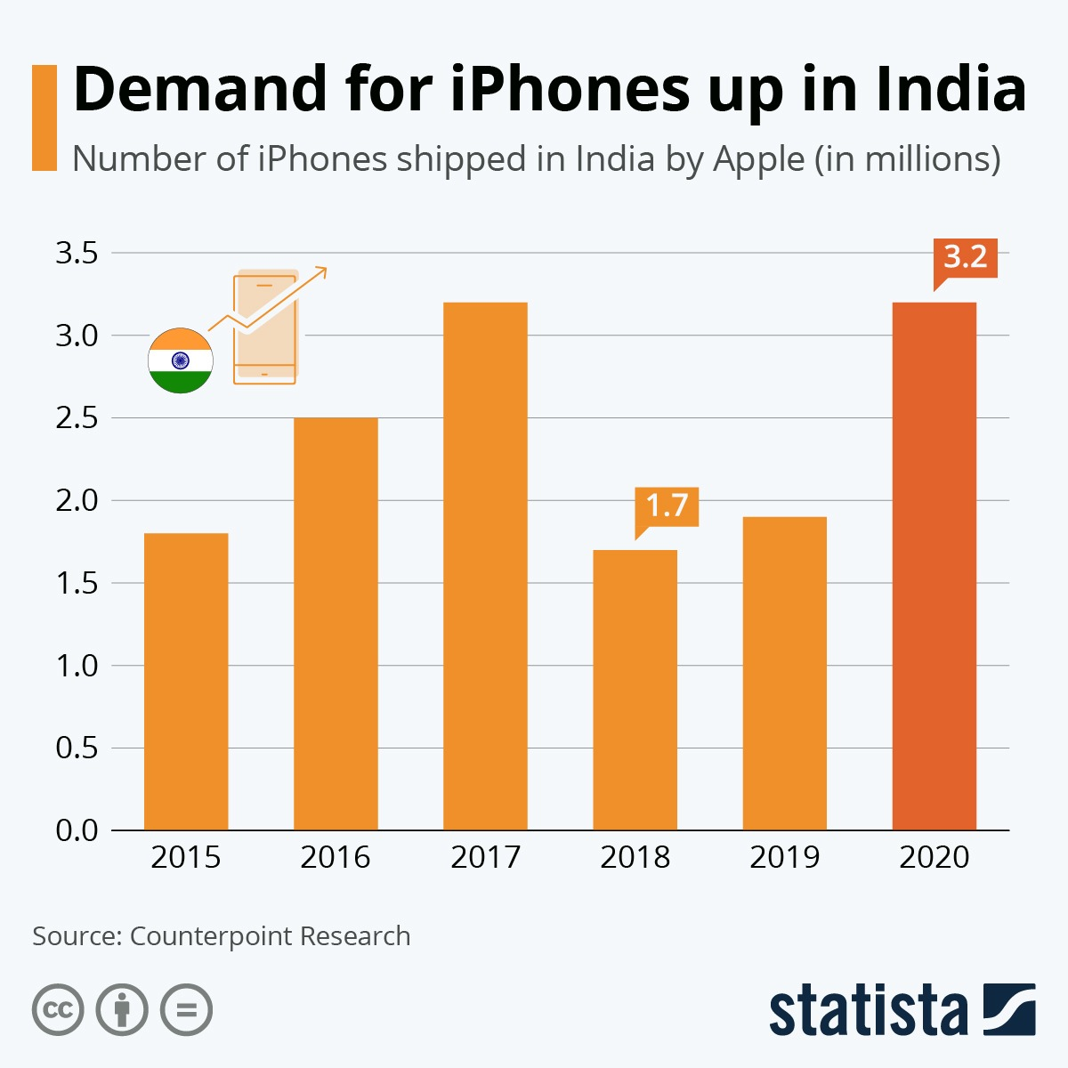
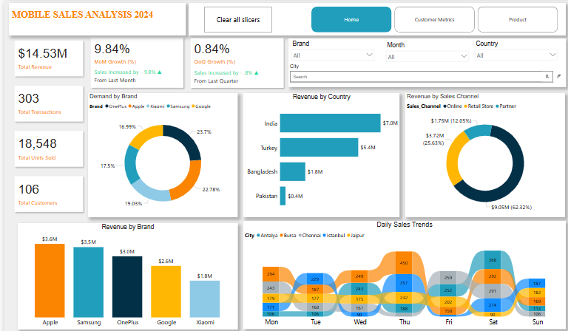

Slide 16
Future Scope and Enhancements
Add More Features :- Include parameters like 5G support, refresh rate, OS version, waterproof ratings
Price Prediction Model :- Use Machine Learning (e.g., Linear Regression, Decision Tree) to predict mobile prices based on specs
Dynamic Dashboard :- Create a real-time interactive dashboard using Power BI or Tableau
Platform Development :- Convert this analysis into a user platform with vendor and admin roles
Global Comparison :- Expand dataset with international pricing and currency normalization

Slide 17
Conclusion
Features like RAM, Storage, Battery Capacity, Camera Quality, and Display Size significantly impact the launch price of smartphones.
Brand reputation plays a crucial role—premium brands generally have higher price ranges despite similar hardware.
Through data preprocessing, we ensured the dataset was clean, structured, and ready for meaningful analysis.
Visualizations (like bar charts, correlation heatmaps, and distribution plots) made it easy to interpret complex patterns.
Identified budget vs premium segment trends, which can help both users and sellers understand the market better.

Slide 18
THANK YOU

